Slide 1

GDPR Compliance in Cloud Security Environments
Presented by: Hadi Hijazi
Student ID: 105174

Slide 2
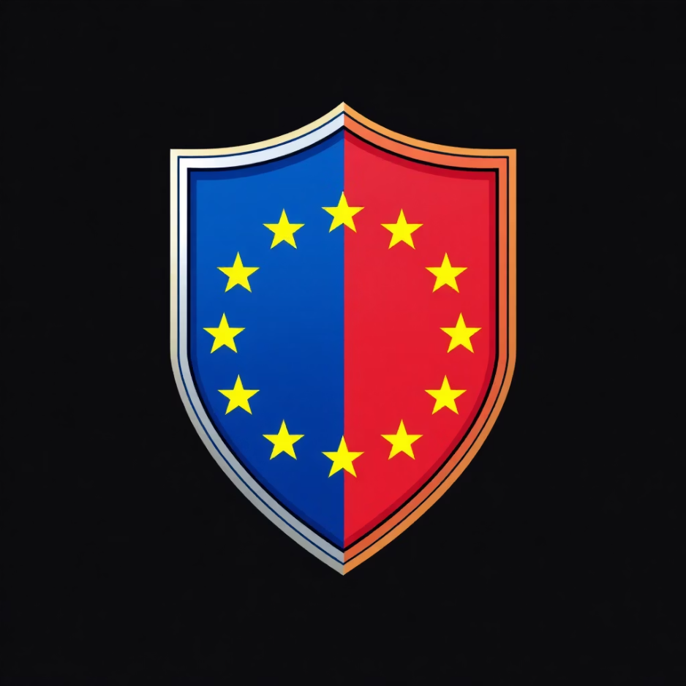
Introduction to GDPR: Protecting EU Data Subjects
The General Data Protection Regulation (GDPR) is a comprehensive EU data protection law safeguarding the privacy rights of individuals within the EU and European Economic Area (EEA). Its core objectives are to empower individuals with greater control over their personal data and to unify data protection regulations across the EU for international business.
Lawfulness, fairness, and transparency
Purpose limitation
Data minimization
Accuracy
Storage limitation
Integrity and confidentiality
Accountability
Non-compliance carries significant penalties, necessitating robust adherence for organizations processing EU data.

Slide 3
GDPR and the Cloud: Shared Responsibility Model
Security OF the Cloud
Security IN the Cloud
AWS is responsible for protecting the infrastructure that runs its cloud services, encompassing physical facilities, network, hardware, and software. AWS ensures foundational security measures.
Customers are responsible for security within their cloud environment, including data, operating systems, network configurations (e.g., security groups), applications, and IAM. GDPR compliance primarily falls under this customer responsibility.

Slide 4
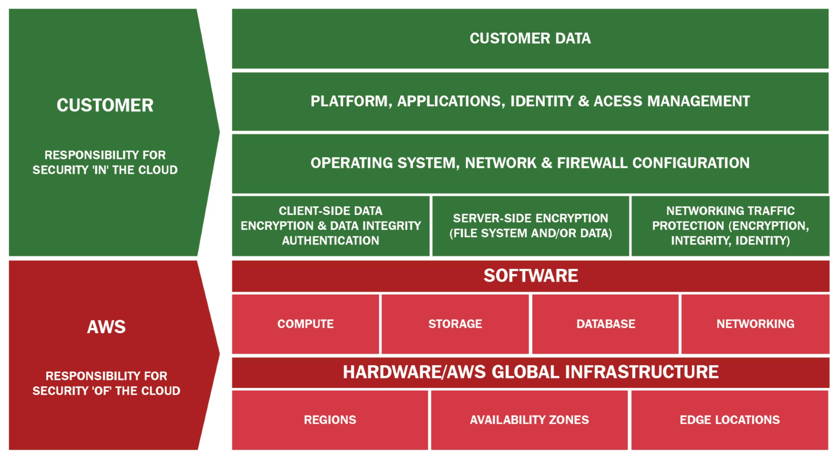

Slide 5

Identity and Access Management (IAM) for GDPR Compliance
AWS Identity and Access Management (IAM) is fundamental for GDPR's "Integrity and Confidentiality" and "Least Privilege" principles, securely controlling authentication and authorization to AWS resources.
Multi-Factor Authentication (MFA): Enhances security by requiring multiple authentication methods, reducing unauthorized access risk.
Role-Based Access Control (RBAC): Assigns permissions based on job functions, ensuring users access only necessary resources and minimizing data exposure.
Fine-grained Permissions: IAM policies enable precise control over resource access, vital for data minimization and processing limitations.

Slide 6

Network Security: Safeguarding Data with Security Groups
AWS Security Groups function as virtual stateful firewalls, managing inbound and outbound traffic for network interfaces, instances, and subnets. They are essential for GDPR compliance, providing technical safeguards to restrict unauthorized access to personal data.
Traffic Filtering: Specify permitted protocols, ports, and IP ranges for instance access, preventing unauthorized connections.
Stateful Inspection: Automatically permit return traffic for established connections, streamlining firewall management without compromising security.
Isolation: Segment networks and control traffic flow to isolate systems processing personal data, thereby reducing the attack surface.

Slide 7



Data Privacy vs. Data Protection in the Cloud
Data Privacy
Data Protection
Concerns the appropriate use and handling of personal data, covering individual rights and policies for its collection, storage, and sharing. GDPR largely focuses on ensuring transparency and consent.
Involves security measures to safeguard data from unauthorized access, corruption, or loss. In cloud environments, this includes implementing technical controls like encryption, directly supporting data privacy.
Key AWS Services for Data Protection:
AWS Key Management Service (KMS): Manages cryptographic keys, enabling data encryption at rest across various AWS services (e.g., Amazon S3, EBS).
TLS (Transport Layer Security): Ensures data encryption in transit, protecting it between client applications and AWS services.

Slide 8
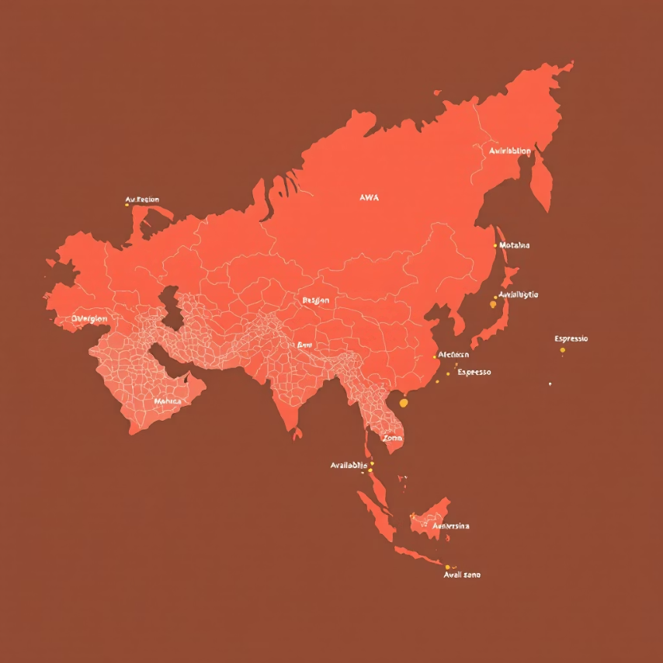
Data Residency & Sovereignty: Regions and Availability Zones
GDPR mandates data residency and sovereignty, particularly for EU data subjects. AWS's global infrastructure, comprising Regions and Availability Zones, is critical for compliance.
AWS Regions: Geographical areas with clustered data centers. Selecting an EU Region (e.g., Ireland, Frankfurt) ensures personal data remains within EU jurisdiction, fulfilling residency obligations.
Availability Zones: Isolated locations within a Region, providing high availability and fault tolerance. They do not impact data residency; data remains within its chosen Region.
Compliance: Proper Region selection is a primary technical control for GDPR compliance, preventing unauthorized cross-border data transfers.

Slide 9
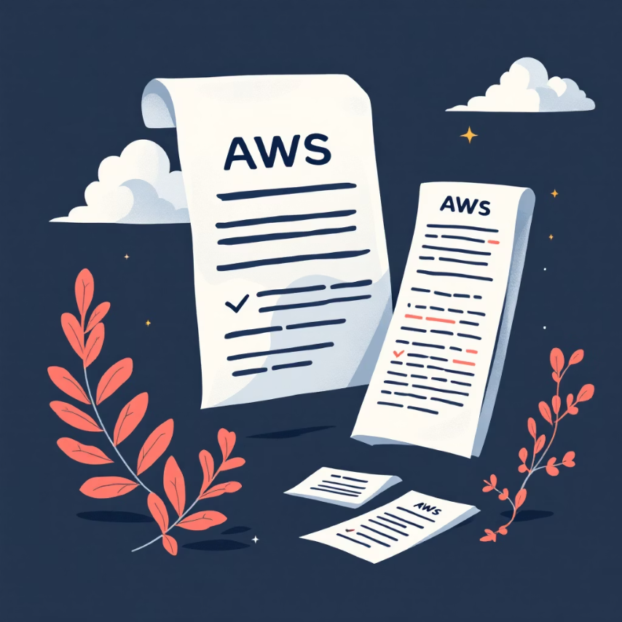
Compliance & Regulations: Demonstrating GDPR Adherence
Demonstrating GDPR compliance is essential. AWS offers various resources to assess and prove adherence to regulatory requirements, supporting audits and internal governance.
AWS Artifact: Provides on-demand access to AWS security and compliance reports, including Service Organization Control (SOC) reports.
SOC Reports (SOC 1, 2, 3): Independent third-party audit reports detailing AWS's compliance controls. SOC 2 reports specifically address security, availability, processing integrity, confidentiality, and privacy, directly supporting GDPR audit evidence.
Compliance Certifications: AWS maintains a broad range of international and industry-specific certifications, which customers can leverage for their own compliance initiatives.

Slide 10
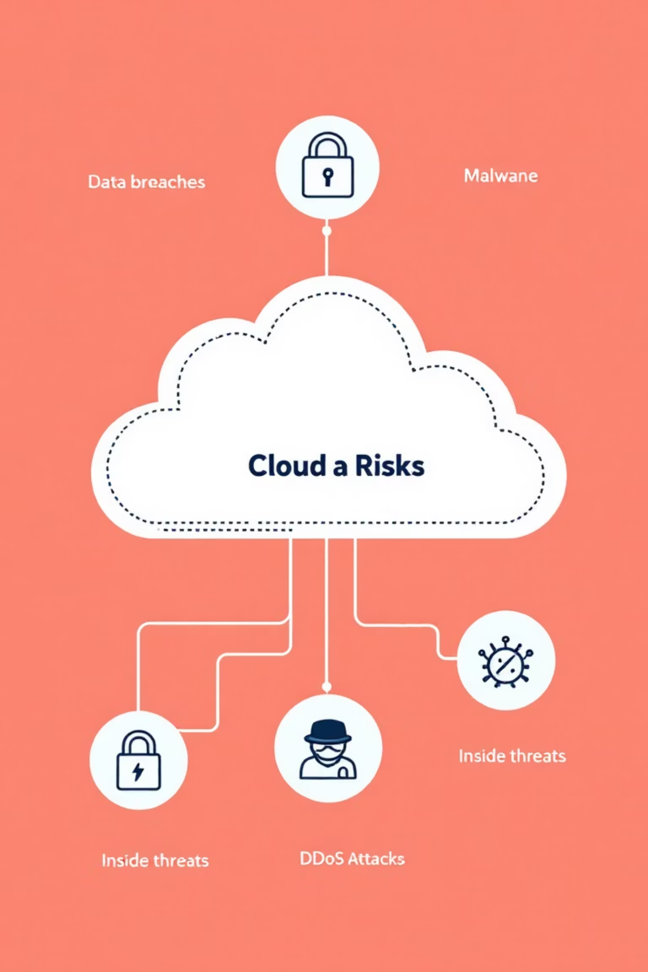



Challenges and Concerns in Cloud GDPR Compliance
Shadow IT
Misconfigurations
Unauthorized cloud service usage by employees creates unmanaged data stores and processing activities, leading to significant GDPR compliance risks.
Incorrectly configured cloud services (e.g., open S3 buckets, overly permissive IAM policies) are a primary cause of data breaches and GDPR violations.
Cross-Border Data Transfers
Transferring personal data outside the EU necessitates specific legal mechanisms (e.g., Standard Contractual Clauses, Adequacy Decisions) for GDPR compliance, presenting a complex challenge for global operations.

Slide 11

Conclusion: Mastering GDPR in the Cloud
This lab explored GDPR compliance within AWS cloud environments. Understanding the Shared Responsibility Model and implementing services like IAM, Security Groups, and KMS are crucial for building robust security, protecting personal data, and meeting regulatory requirements.
Proactive planning, continuous monitoring, and leveraging AWS compliance resources are essential for mitigating risks and demonstrating accountability. GDPR compliance is an ongoing process, demanding technical expertise and a deep understanding of legal obligations.

Slide 12
Thank you!

